Slide 1
Programmable Logic Devices
PLDs

Slide 2
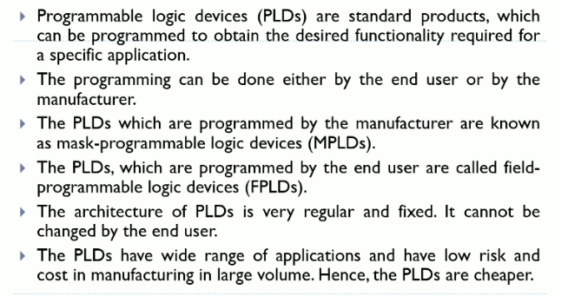

Slide 3
Types
PAL(Programmable Array logic)
PLA(Programmable Logic Array)
CPLDs( Complex Programmable Logic Devices)
FPGA (Field Programmable Gate array)
ROM/PROM

Slide 4
Programmable Array Logic (PAL)
programmable array logic is a architecture logic device with programmable AND gate by fixed OR gate.
Simple in structure
Issues regarding flexibility

Slide 5

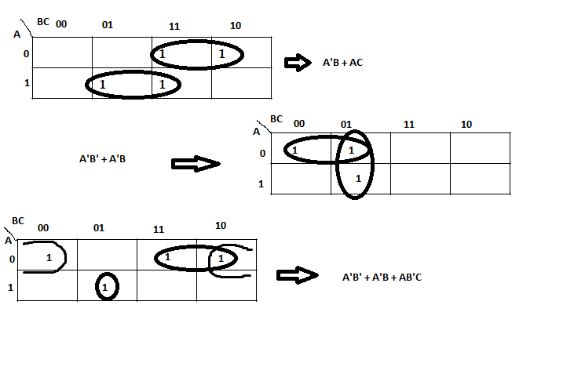
K-map

Slide 6
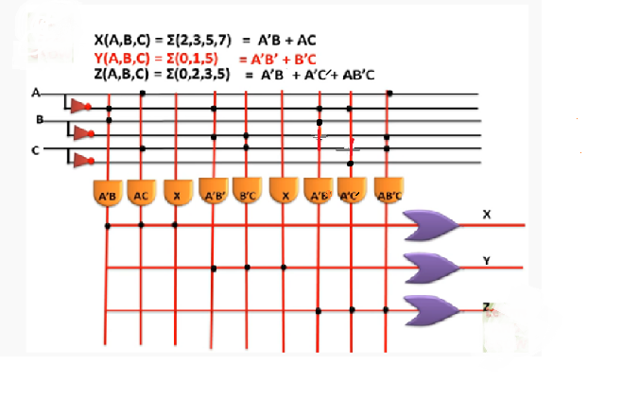
Cont.

Slide 7
Programmable Logic Array (PLA)
In Programmable Logic Array (PLA) both AND and OR gate are programmable
No. of AND gate is equal to no of minterm and no. of OR gate is equal to no. of function

Slide 8
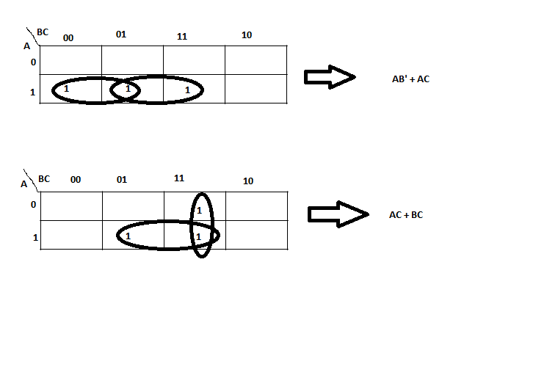
K- map
F(A,B,C) = ∑(4,5,7)
F(A,B,C) = ∑(3,5,7)

Slide 9
